Slide 1
A Secure Network for Institution
Designing a secure network for Institution.
Presented by: Aditya Raj

Slide 2
Devices Used
Mail server, web server, FTP server and DNS server
Router
Switches
PC’s, Laptop
Printer

Slide 3
2. Network
We have divided our divided our entire college network in 6 components interconnected with switches and routers
Each network component is connected to a separate switch.
Feature of designed network are performance, data sharing, reliability and security

Slide 4
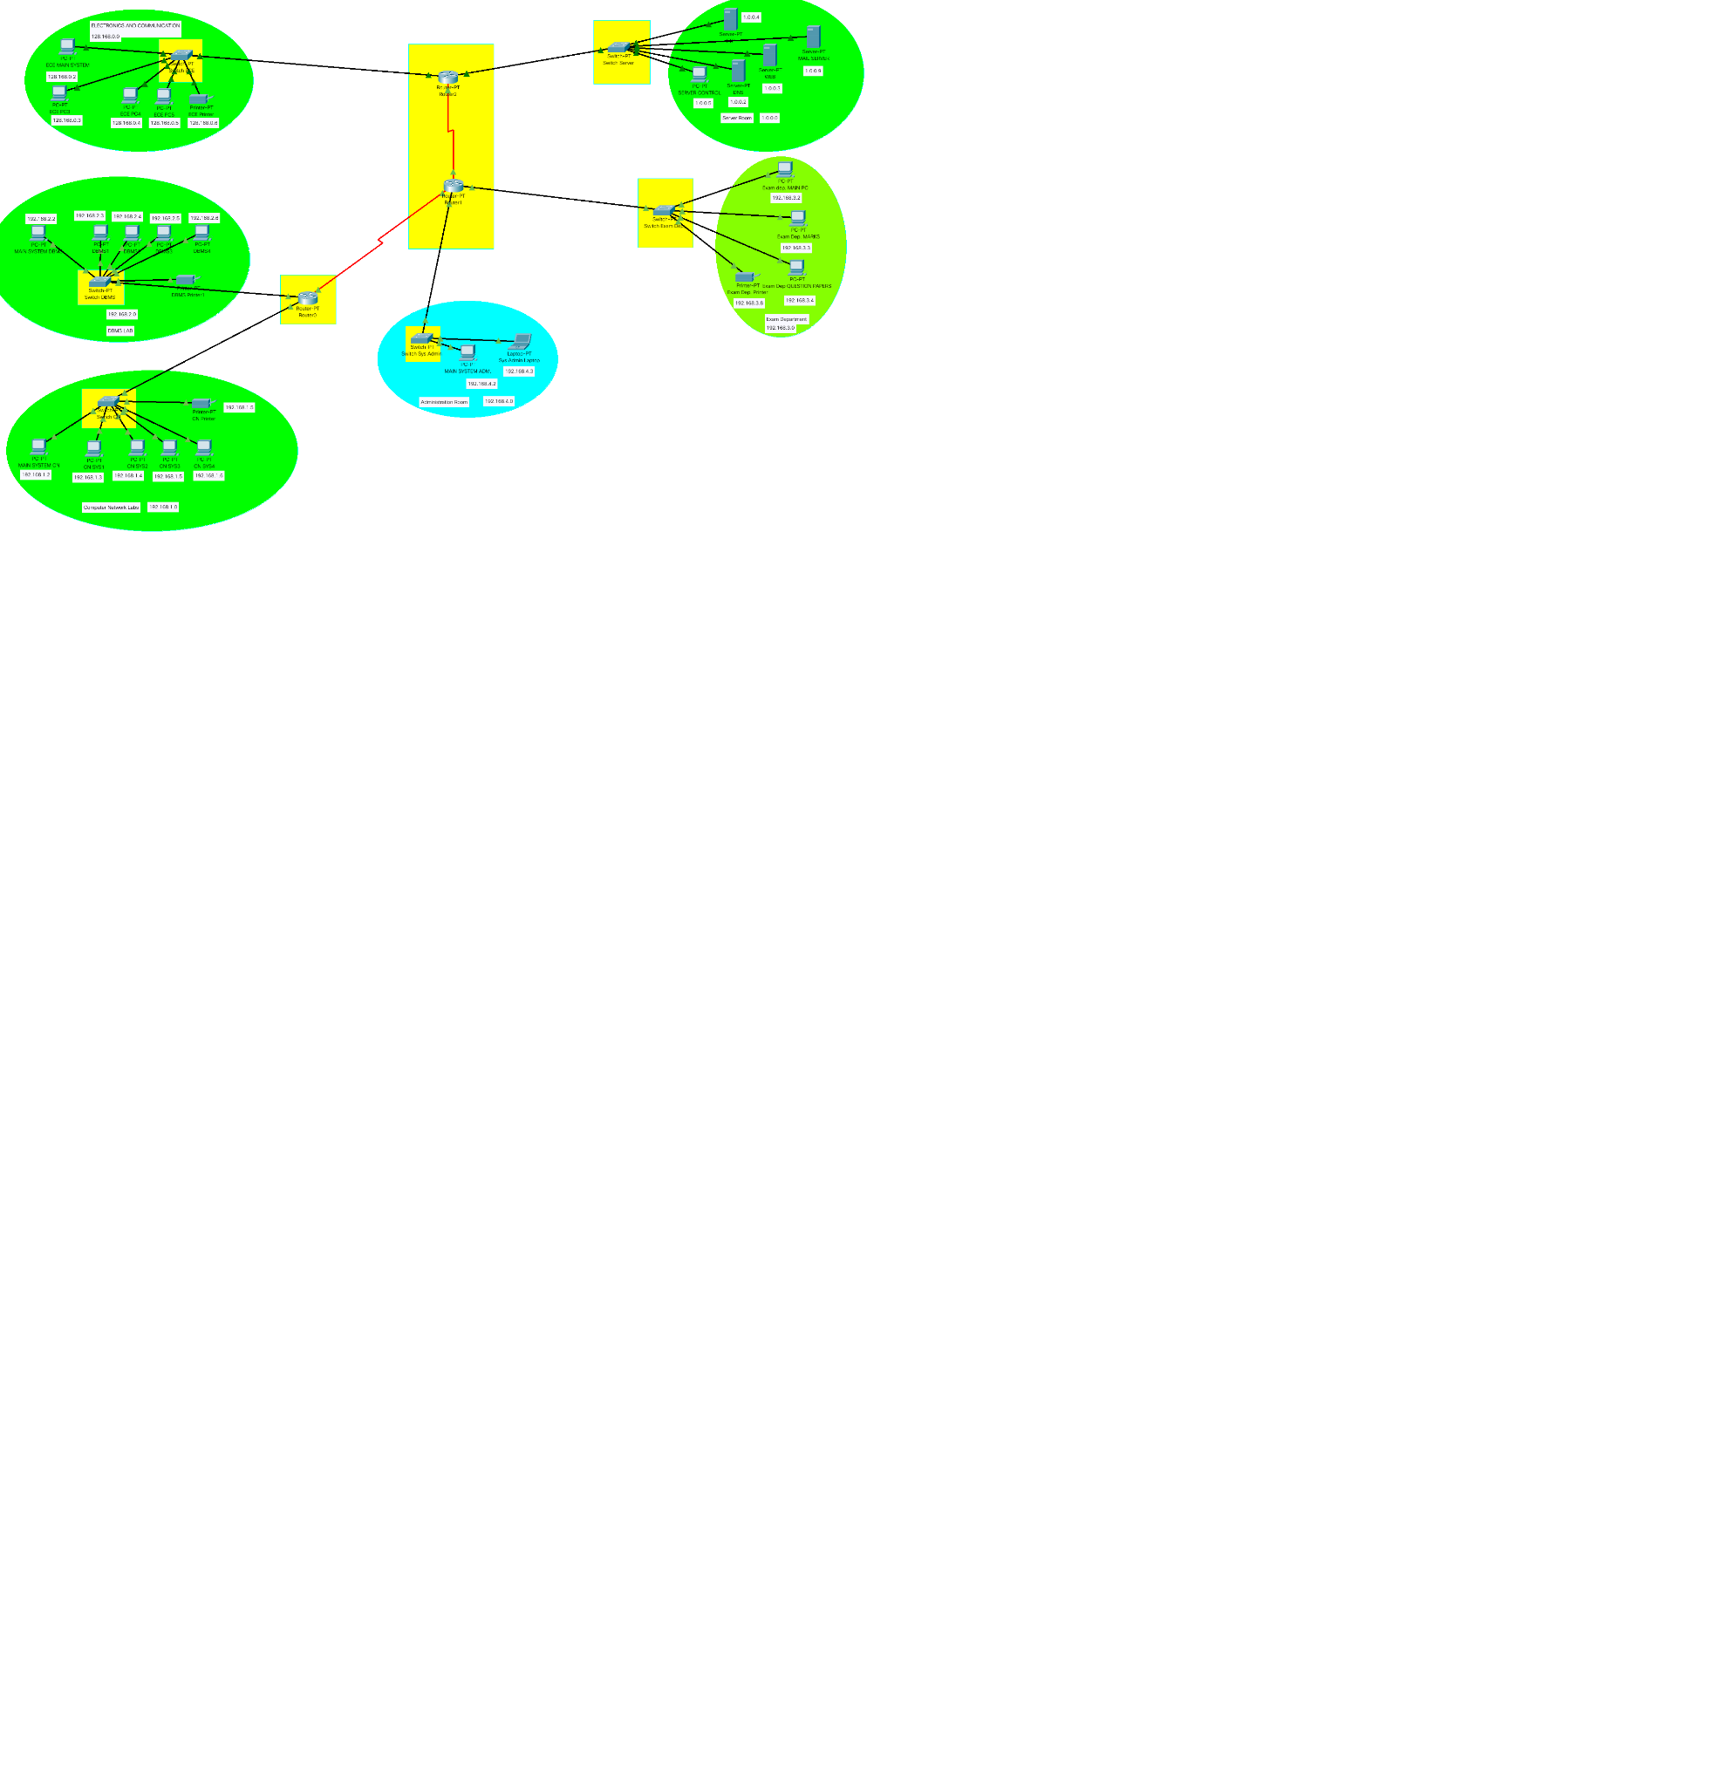
Network

Slide 5
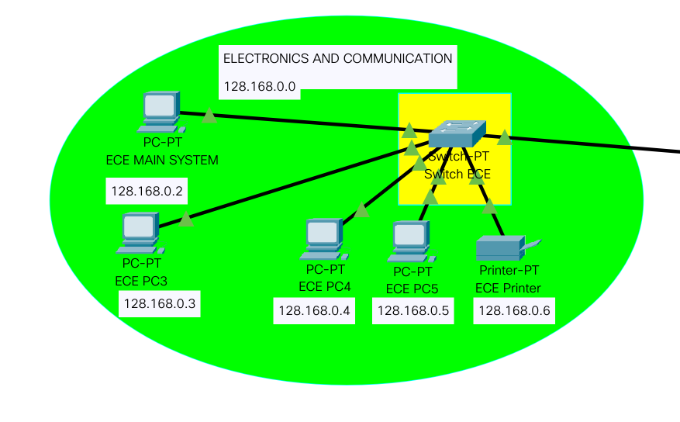
2.1 Electronics and Communication Department
Devices are connected to network ID : 128.168.0.0

Slide 6
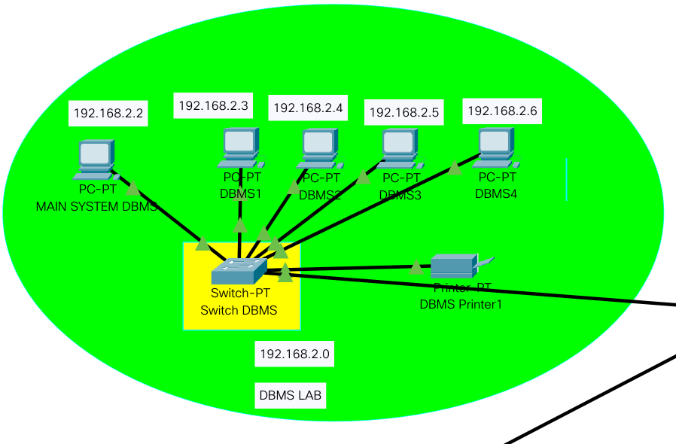
2.2 Database and Management LAB
Devices are connected to network ID : 192.168.2.0

Slide 7
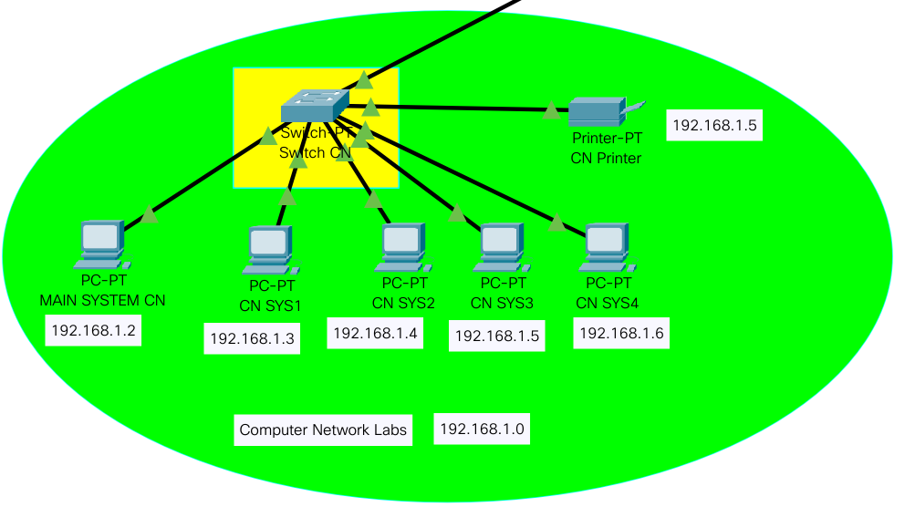
2.3 Computer Networks Lab
Devices are connected to network ID : 192.168.1.0

Slide 8
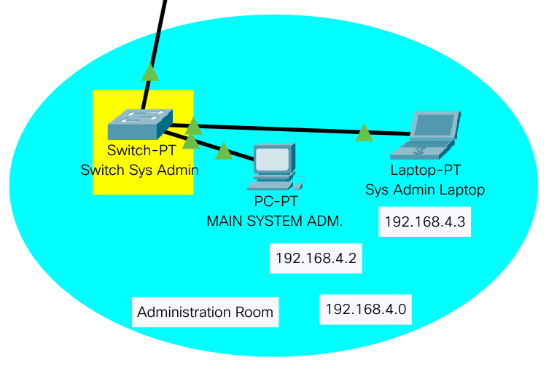
2.4 Administration Room
Devices are connected to network ID : 192.168.4.0

Slide 9
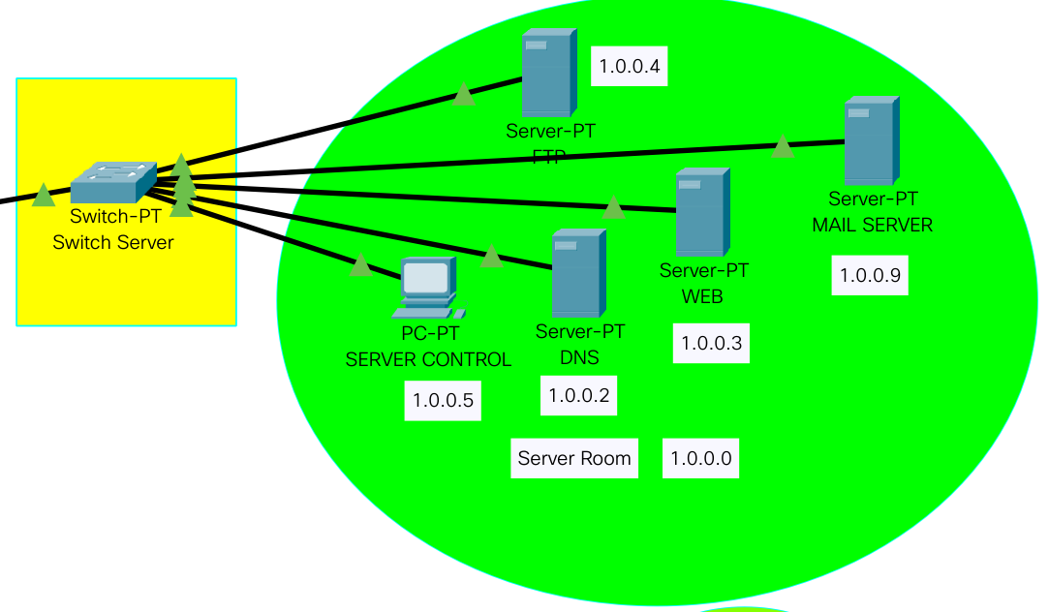
2.5 Server Room
Devices are connected to network ID : 1.0.0.0

Slide 10
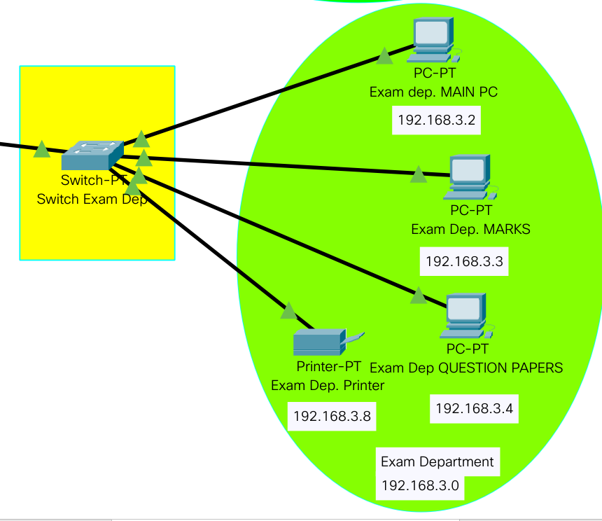
2.6 Examination Department Room
Devices are connected to network ID : 192.168.3.0

Slide 11
3. Security Feature
Identification
Data Privacy
Policy Management

Slide 12
4. Expected Attack
Denial of Service
Spoofing
Social engineering

Slide 13
4.1 Solution
Creating awareness in the institute related to the best practices for working with network
Firewall
Adding anti-DoS hardware in near future
Packet Filtering scan and block packets that contains conflicting source address information.
Sending alert to user if any unusual behaviour is noticed.

Slide 14
CONCLUSIONS
The premise of network education is the construction of the network, and as the construction of the campus network
The premise of network education is the construction of the network, and as the construction of the campus network is not only the construction of the network hard environment.
maintenance and security, campus network resources and the effective application of the campus network and other three Link

